Slide 1
Curious About AI/ML?
Steps Towards Adoption
Presented by ISAIC
Notes:
Good morning - Thanks for invite XYZ for organizing. I’m XYZ and XYZ is also here from ISAIC.
It seems there XYZ in audience - please say hi in chat and tell us which area you’re from, what you most want to learn today. And feel free to use chat to ask questions anytime.
The presentation is about 15mins - a quick introduction then the Why? What? Who? of ISAIC. Then questions - the frequently asked questions or yours directly

Slide 2
PollEv.com/isaic712

Slide 3
Agenda
AI in Everyday Lives
Things We Need to Adopt AI
Data Hierarchy of Needs
Where ISAIC Comes In
Key Learning

Slide 4
AI in Everyday Lives
Notes:
So that’s where ISAIC fits in

Slide 5
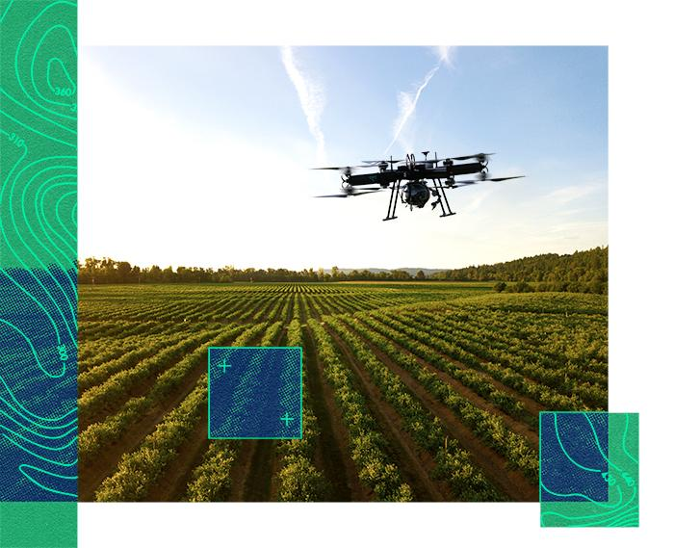
Precision AI from Saskatchewan
Builds artificially intelligent drones that autonomously survey fields in real-time to recognize plant growth and spot-spray weeds with surgically targeted micro-doses.
With AI technology, Precision AI forecasts up to 85% savings in herbicides.

Slide 6

Clinisys from Alberta
Clinisys is developing electronic medical record solutions since 2011. The software products we provide to the market include EMR (electronic medical health record systems) and disease registries.
“There were so many blank areas (in AI) that we were not familiar with. EMR was the focus. But EMR is a massive amount of data. So we had the opportunity to leverage this information for more solutions. Our analytics AI/ML side significantly developed from 0 to 50% of our business/product line. That is proof of what this kind of ecosystem and infrastructure can provide.”

Slide 7
Components of AI adoption
Notes:
So that’s where ISAIC fits in

Slide 8
AI Adoption Requirements & SME Challenges
Human Competency
Data
Challenges:
AI skills
IT skills
Domain understanding
Change & buy-in
Challenges:
Limited access to data
Data may not be ready for AI
Potentially missing insights due to disconnects in data
Privacy concerns
Factors Driving Application of AI
Computation
Challenges:
Limits the speed at which AI solutions can be developed
Hidden cost
On prem and hybrid are prevalent
Market offerings are complicated and fragmented
Notes:
Likely a reminder, the high level requirements for any AI project are data, compute and people skills.
Data and data scientists are generally well recognized now as core elements of AI / ML projects
AI / ML projects is clean, normalized, high quality training data. 60-80% of the time spent on the project is taken up here. And the key to high-quality training data is a process to obtain, analyze, and curate the data. Training data rarely arrives in a high-quality form [ ] somebody has to take the time to bridge the gap between the creators of the data, and the people (e.g., ML researchers) analyzing the data.”: Paul Lu 2018 University of Alberta.
Computational resources (or compute) are often under-recognized - especially as a cost given the expectations of up front credits, hardware speed of evolution and alternatives and mid-long term implications of vendor lock-in - and compute is often not included in project charters or grants
and for People - systems, computer and electrical engineers, domain experts, software developers, Ux/Ui, etc are also critical to a successful project yet less known alongside the critical project and change managers and translators or integrators of value and ROI
Ethics processes & support may not be available

Slide 9
Data Hierarchy of Needs
Notes:
So that’s where ISAIC fits in

Slide 10
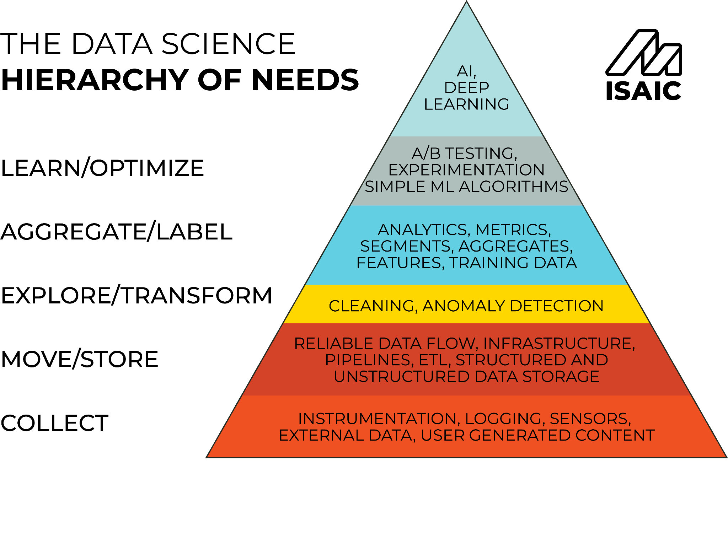

Slide 11
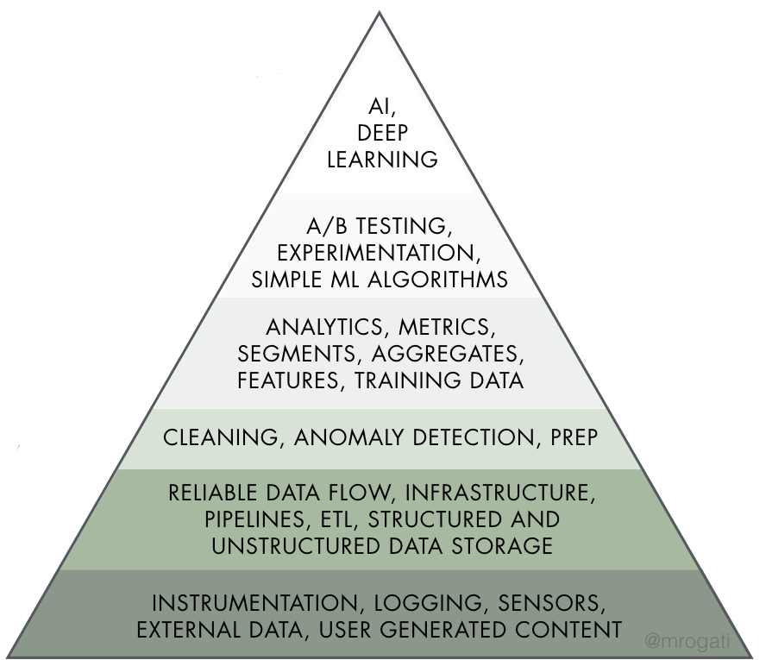
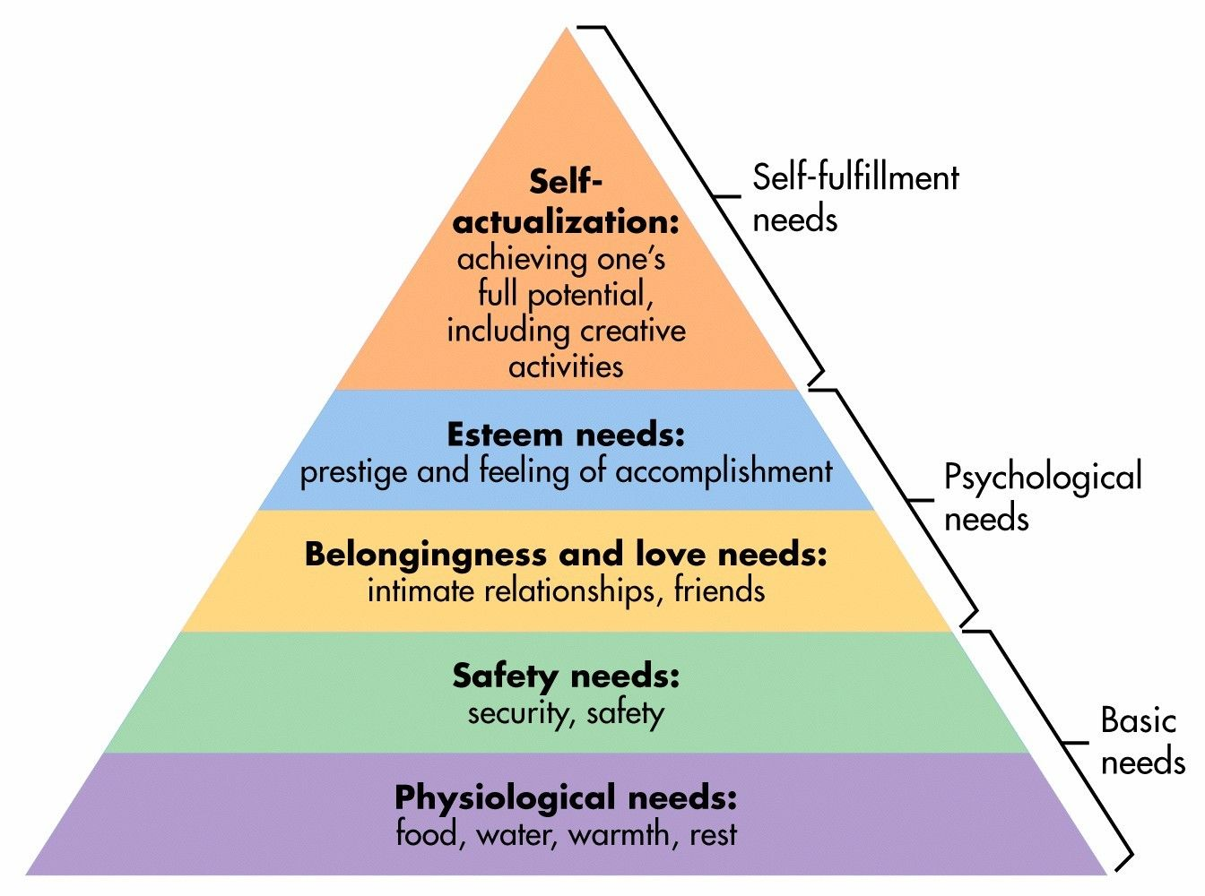
Similarities to Maslow’s hierarchy of needs

Slide 12
Data Collection
Notes:
So that’s where ISAIC fits in

Slide 13
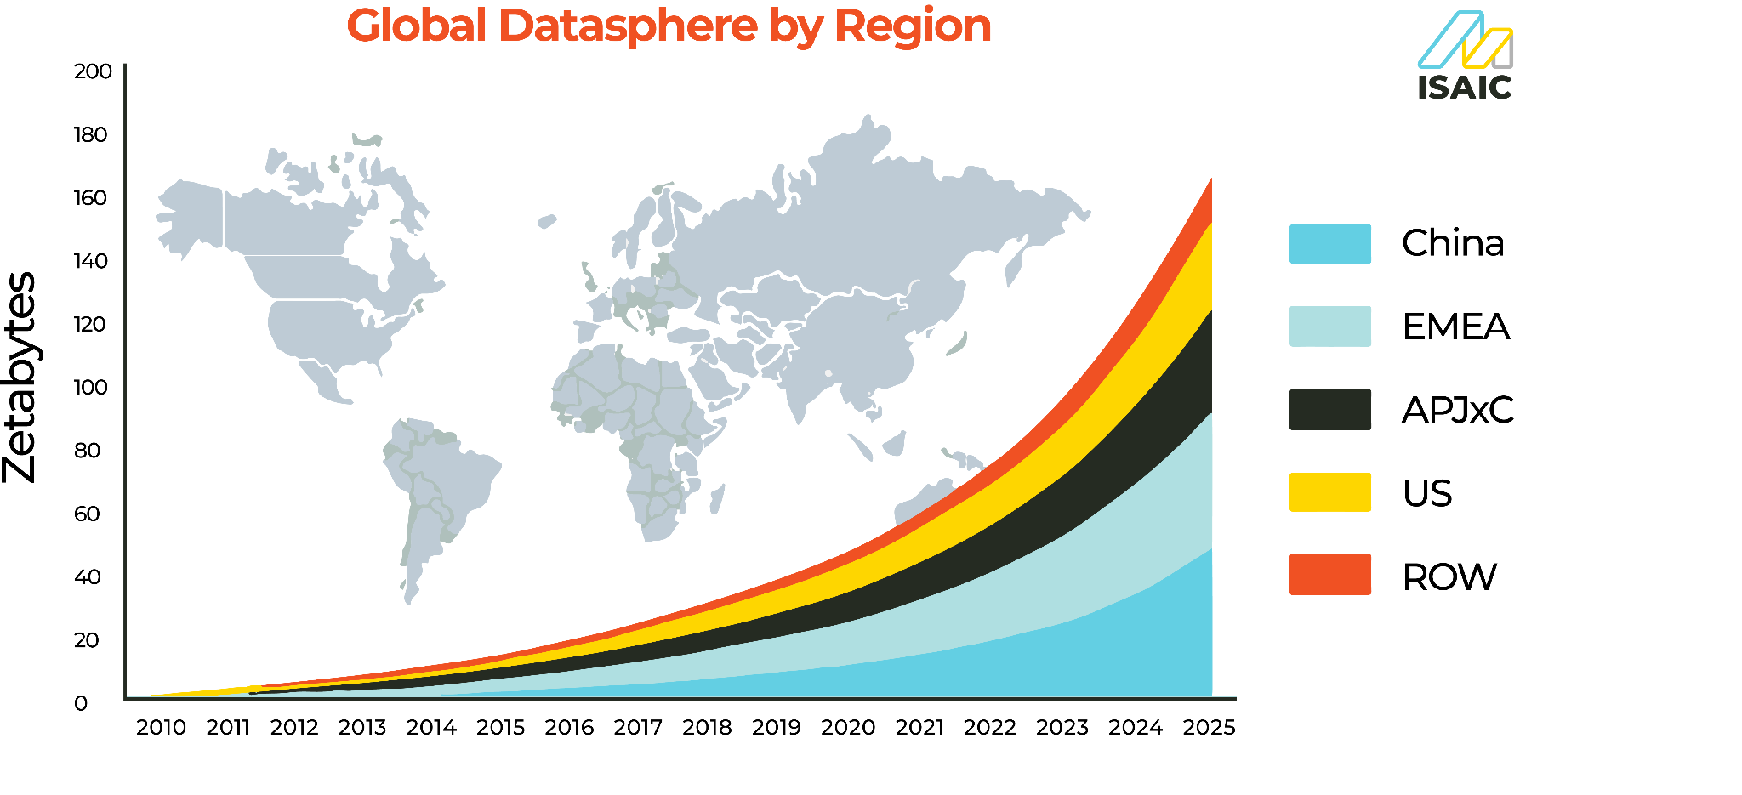
Data is the New Gold Rush
Data Collection
(1,000,000 TB)
Source: IDC’s Data Age 2025 study, sponsored by Seagate
Notes:
With the increasing adoption of AI and ML there has been a significant increase in the demand for data. As a result data collection has become a huge part of business and organisations that are transitioning to AI and this is similar to the gold rush in the 1800’s. Every bit of data matters in this age and good and reliable data is what makes a good product.
1 million terrabyte

Slide 14
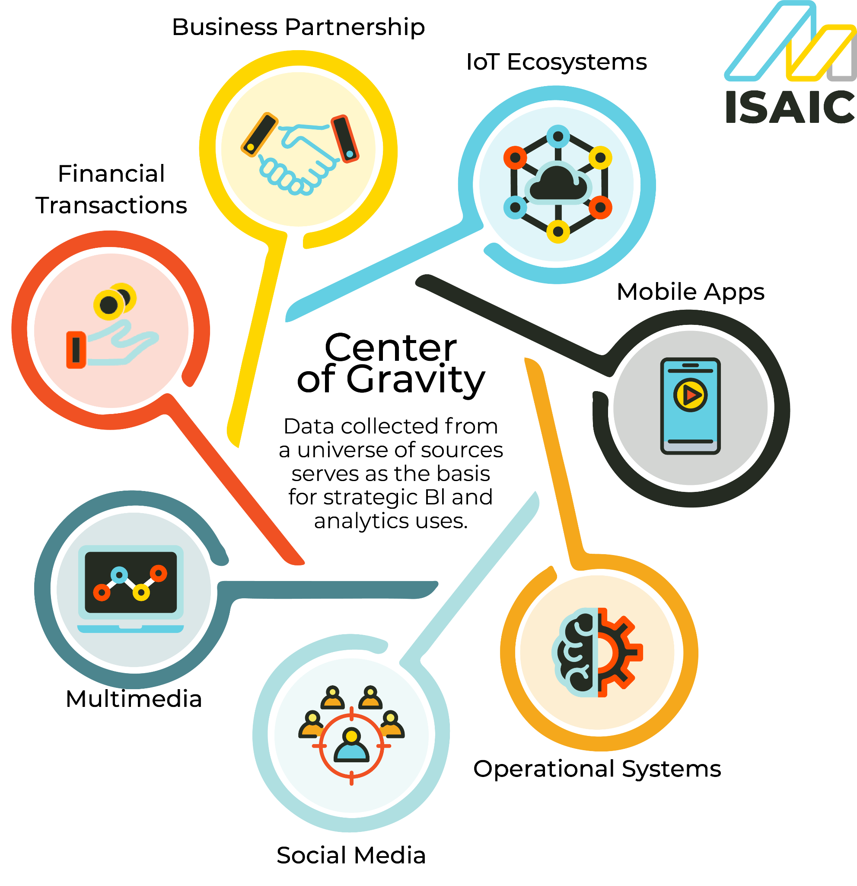
Multi-faceted and Multi-source Data
Data Collection
Source: TechTarget
Notes:
automated data collection functions built into business applications, websites and mobile apps;
sensors that collect operational data from industrial equipment, vehicles and other machinery;
collection of data from information services providers and other external data sources;
tracking social media, discussion forums, reviews sites, blogs and other online channels;
surveys, questionnaires and forms, done online, in person or by phone, email or regular mail;
focus groups and one-on-one interviews

Slide 15
Challenges in Data Collection: The 5V Scheme
Data Collection
Volume
Velocity
Variety
Veracity
Value
Notes:
https://www.bbva.com/en/five-vs-big-data/
Velocity - real-time, variety - multisource, veracity - quality, value - insights
automated data collection functions built into business applications, websites and mobile apps;
sensors that collect operational data from industrial equipment, vehicles and other machinery;
collection of data from information services providers and other external data sources;
tracking social media, discussion forums, reviews sites, blogs and other online channels;
surveys, questionnaires and forms, done online, in person or by phone, email or regular mail;
focus groups and one-on-one interviews

Slide 16
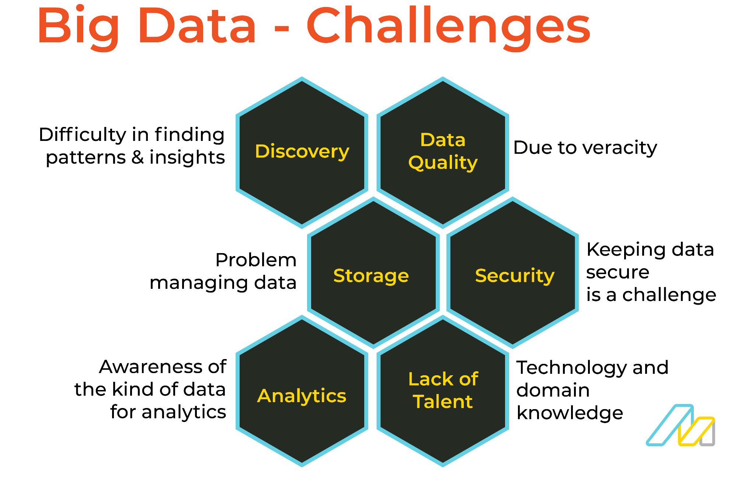
Other Data Challenges
Data Collection
Storage
Privacy
Reality in the Field (lack of Connection in Rural Areas)
Cost of Expertise and Scarcity of Experts
Notes:
automated data collection functions built into business applications, websites and mobile apps;
sensors that collect operational data from industrial equipment, vehicles and other machinery;
collection of data from information services providers and other external data sources;
tracking social media, discussion forums, reviews sites, blogs and other online channels;
surveys, questionnaires and forms, done online, in person or by phone, email or regular mail;
focus groups and one-on-one interviews

Slide 17
Data Storage
Notes:
So that’s where ISAIC fits in

Slide 18
PollEv.com/isaic712

Slide 19


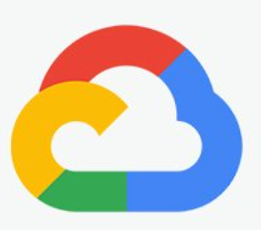


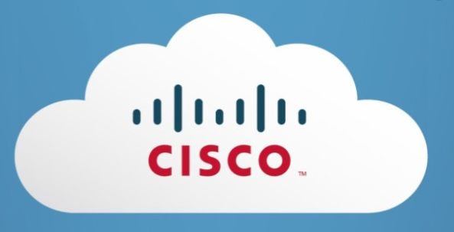




Options for Infrastructure and Data Storage
Data Storage
On-premises, Co-location
Purchased hardware/infrastructure becomes obsolete
Hard upkeep & scale (human resources, capital, space)
Cost due to speed of evolution & intermittent use
Local providers
Relationship-based support
No lock-in or hidden charges
Scalability & secure
I.P. is Yours, data sovereignty
Less risk, no maintenance
OTT
Enterprises
Platform effect
Switching costs
Unpredictable costs
Automated support
Research compute
Mostly for researchers
Scheduled
By competition
Limited access
Capacity versus demand

Slide 20
Data Transformation and
Data Aggregation
Notes:
So that’s where ISAIC fits in

Slide 21
Collected Raw Data Needs Cleaning
Data Transformation, Data Aggregation
Data transformation and cleaning involves (You pay a data scientist to do this ):
Image preprocessing
Voice and sound noise reduction
Sorting and ordering
Filling in Missing Values
Why Transformation?
Higher data fidelity
Faster path to the optimal solution
🗑 in 🗑 out
Notes:
How to transform data:
Extraction and parsing
Translation and mapping
Cleaning, Filtering, aggregation, and summarization
Enrichment and imputation
Indexing and ordering
Anonymization and encryption
Modeling, typecasting, formatting, and renaming

Slide 22
Data Transformation, Data Aggregation
Data Aggregation & Fusion
In cases that data comes from multiple sources:
Data should be aggregated and fused together from multiple sources
If done improperly, inference biases can happen
Life & death decisions (Medical)
Socio-economic decision making & urban planning (Gentrification)
Judicial cases (biases in convictions)
Thus, you will need experts to perform data aggregation
Notes:
Medical
Face ID and
Depending on the nature and the data you have, it may inference bias

Slide 23
Building & Optimizing the
Model

Slide 24
Building & Optimizing the Model
The Capstone of the Pyramid
ML Developers build models with AI Frameworks and APIs
Finding best model and algorithm
There is no one size fits all (a universal solution)
Feed the data to the model
Accelerated through GPU Optimization (Data Intensive and Parallel Solutions)
Accelerated through Tensor Processing
Test, Evaluate and then Repeat
Repeat to adjust the Model Parameters
Repeat to find the best Models and Techniques

Slide 25
Building & Optimizing the Model
Different Models That Are Out There And Their Complexities
Statistical Models (CPU Intensive, Low Complexity) e.g. Housing Market Prediction, Fraud Detection, Disease Detection
Deep Learning Models (GPU Intensive, Higher Complexity) e.g. Natural Language Processing, Personal Virtual Assistants (Alexa), Computer Vision
Time-series, Gated, and Graph-based Models (GPU and CPU Intensive, Very High Complexity) e.g. Stock Market Analysis, Weather Prediction, Social Network Analysis

Slide 26
Key Learnings
Notes:
So that’s where ISAIC fits in

Slide 27
PollEv.com/isaic712

Slide 28
Key Learnings
Adopting AI in a business is a multifaceted challenge, requiring IT and AI skills and in a wide range of domains
For organizations to enable AI and ML, they need a business understanding of the problem they want to solve and the proper data for that problem
The pyramid encapsulates the essence of steps required to making an AI-enabled organisation

Slide 29
Where ISAIC Comes In
Notes:
So that’s where ISAIC fits in

Slide 30

Who We Are
ISAIC [ai-zey-ihk]
Meets the need of small and medium-sized enterprises (SMEs) for their infrastructure and know-how that accelerates adoption and commercialization of AI in Western Canada.
~3000 tech cos in AB
340,000 SMEs in W.C.
an increase of 149% over 2018
account for 92% of W.C workforce
⅔
~16,000 tech jobs in AB
start-up survival rate past year 5
51.3% projected rate of AI adoption for SMEs
Notes:
To clarify, ISAIC, the acronym which stands for Industry Sandbox and AI Computing
ISAIC is physically located (meaning the infrastructure and workstations) at the University of Alberta from where service is extended across campus, the province and Western Canada as a for benefit organization
AISHub was founded in 2019 and we received funding from Western Economic Diversification (now PrairiesCan).
In short, we provide scalable, tailored, virtual computation and sandboxing environments with in person tech support that helps local companies on their AI adoption journey
Some stats give some context on this our (and for many of you) market
(Industry Canada, 2021) approx 340,000 SME’s in WC, making up 92% of the total Western Canadian workforce
(Deloitte) forecasted annual growth for rate for AI adoption in Canada through 2023 is 51.3% for SMEs
(Industry Canada) new start-ups = every year an average of 96,000 SMEs’ are created in Canada. 80.5% of these survive past year 3 and 66.2% survive past year 5
(Alberta Enterprise, 2021) 3,083 tech companies in AB, a 149% increase over three years ago
(Industry Canada, 2020) ~16, 380 tech jobs in AB. A100 is driving for 75,000

Slide 31
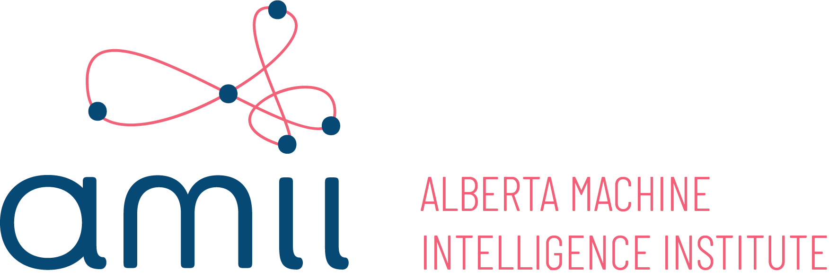
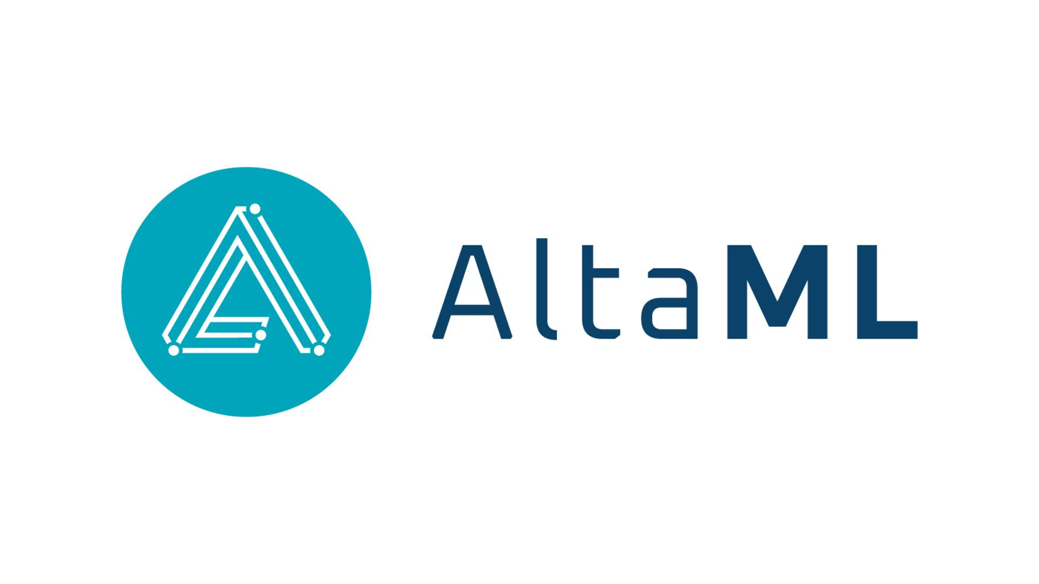

Local Organisations That Can Help with AI Adoption
Applied Data Science
“Infrastructure & applied knowledge”
“Cultivate scientific excellence, develop talent and coach”
Infrastructure
AI Training
Industry specific or turnkey = “Develop powerful software applications”
“Driving growth through digital technology”
Notes:
How they’re packaged together creates different options for SMEs -
We work together and compete, which from the industries I’ve been in - engineering, construction, environment, trade, finance - is normal

Slide 32



Your “Friendly Neighbourhood Cloud”
Open-Access, Cloud Compute
(AI Garage)
Secure Experimentation & Data Collaboration Environment*
(Data Sandbox)
Applied Knowledge for AI Adoption
(Hub)
Affordable, tailorable, flexible GPUs, CPUs, platforms, tools, environments, add-ons, etc.
Infrastructure as a backbone
Secure, local collaboration
environment for SME’s, industry working with researchers, events
Storage options
Partner and assist directly to data related constraints for using and sharing data
Tailored supports, connections and problem-solving for SMEs in Western Canada
Bringing together entrepreneurs, researchers, firms, and students
Notes:
Talked about what ISAIC is at a high level, more specifically what we are is
computational resources and tools - think of it as a virtual garage - private and shared - where you can train and learn on some powerful equipment both proven and leading that often is not available, particularly to SMEs
data sandbox is a place to bring together data, find data and work together in a secure, less-risk virtual space where collaborators can get the right combinations, resources, pre-process to train algorithms
and the community is about the mentoring, match-making and game-changing coalitions that make sense for SMEs (which you know well at Innovates)

Slide 33



What makes different?
Fast / Scalable
Secure
Expert Support
Local
Customizable
Relationship
Notes:
Accelerate. At whatever the scalability and tailorability companies need, our compute resources give the dedicated environment and speed that makes sense and stays affordable
Trusted, sovereign and local. Part of our mandate is to diversify Western Canada’s economy. Data is secured in Canada.
Ownership. Our users own and retain their own IP. Our environment is protected at multiple levels and admin access to the VM is only there if clients want it to be.
Certainty of price and availability. allows users access to their virtual machines at any time. Clients train at their pace, not at a providers.
Simple. We approach service with applied knowledge. ROI is our business goal, so we tailor to your needs and dive in as much or little as needed to provide practical solutions that to drive to results.

Slide 34

Contact Us
www.isaic.ca
Technical Team
support@isaic.ca
@poweredbyisaic
LinkedIn.com/company/poweredbyisaic

Slide 35
Any Questions ?
Notes:
So that’s the overview.
Time - we still have ## mins
So - I can take you ?s or have 5 FAQs prepared

Slide 36
Extras
Notes:
So that’s the overview.
Time - we still have ## mins
So - I can take you ?s or have 5 FAQs prepared

Slide 37
Pricing: laddered, pay for use, local benefit
Your Need
ISAIC Offering
Pricing Approach
On Demand
Hourly
Subscription
Pricing calculator
Standard Offerings
Project Based, Iteration
Fixed fee
Subscription + hourly
Quotation based
CapEx / OpEx Spend
Custom Offerings
Mid-Long Term, Constant
Term Subscription
Quotation based
Procured infrastructure
Contract based
Managed Colocation
** Free time trial for virtual machine, onboard or offboard anytime

Slide 38
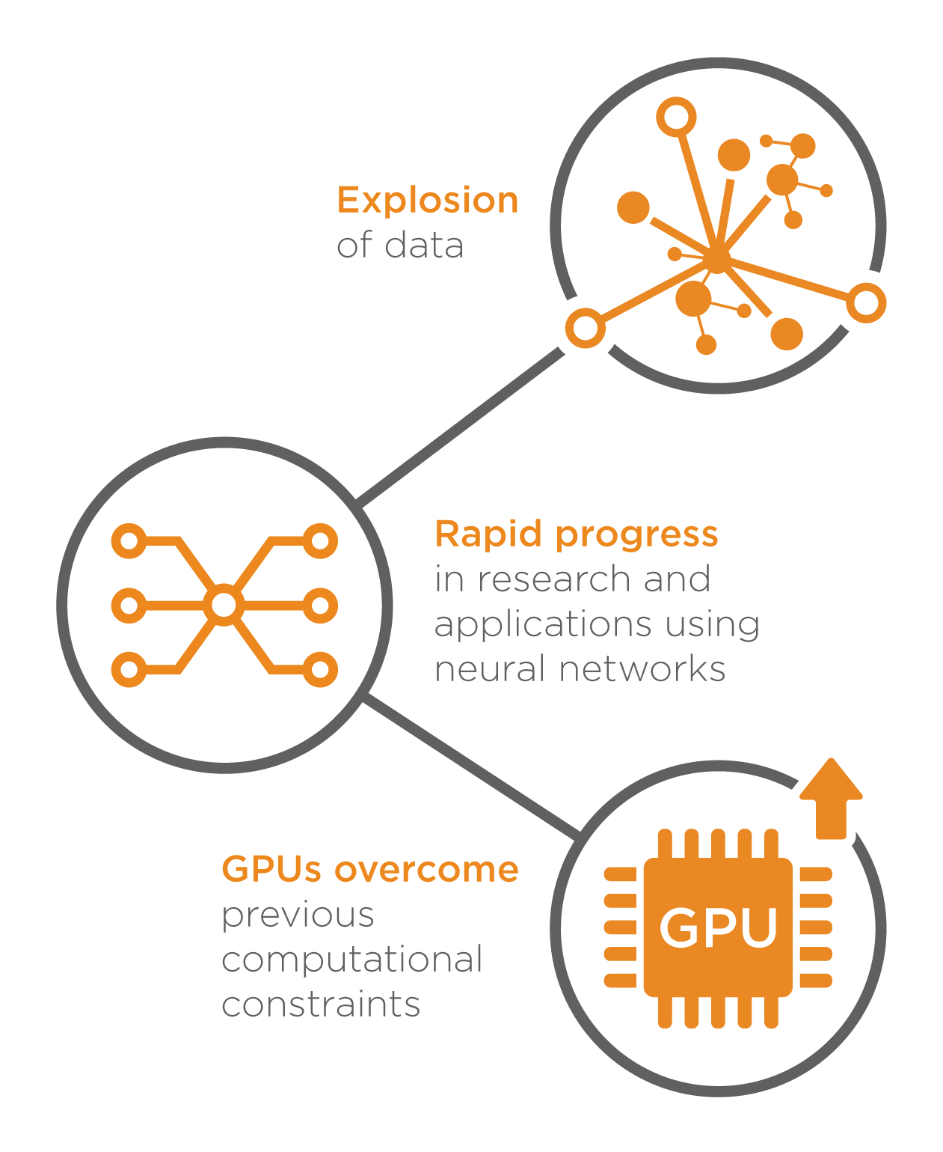
The AI Trinity
The story of AI can be told in three parts: the data deluge, improvements in hardware, and algorithmic breakthroughs

Slide 39
Building & Optimizing the Model
Its time for Building & Optimizing the Model
and using ML and deep learning to finally start training and making our own models. However we still need to have a A/B testing or experimentation framework in place, so we can deploy incrementally to avoid disasters and get a rough estimate of the effects of the changes before they affect everybody. This is also the right time to put a very simple baseline and metrics in place.

Slide 40
‘Wait, what about that Amazon API or TensorFlow or that other open source library? What about companies that are selling ML tools, or that automatically extract insights and features?’
All of that is awesome and very useful. (Some companies do end up painstakingly custom-building your entire pyramid so they can showcase their work.) However, under the strong influence of the current AI hype, people try to plug in data that’s dirty & full of gaps, that spans years while changing in format and meaning, that’s not understood yet, that’s structured in ways that don’t make sense, and expect those tools to magically handle it. And maybe some day soon that will be the case.
Until then, it’s worth building a solid foundation for your AI pyramid of needs.

